Slide 1
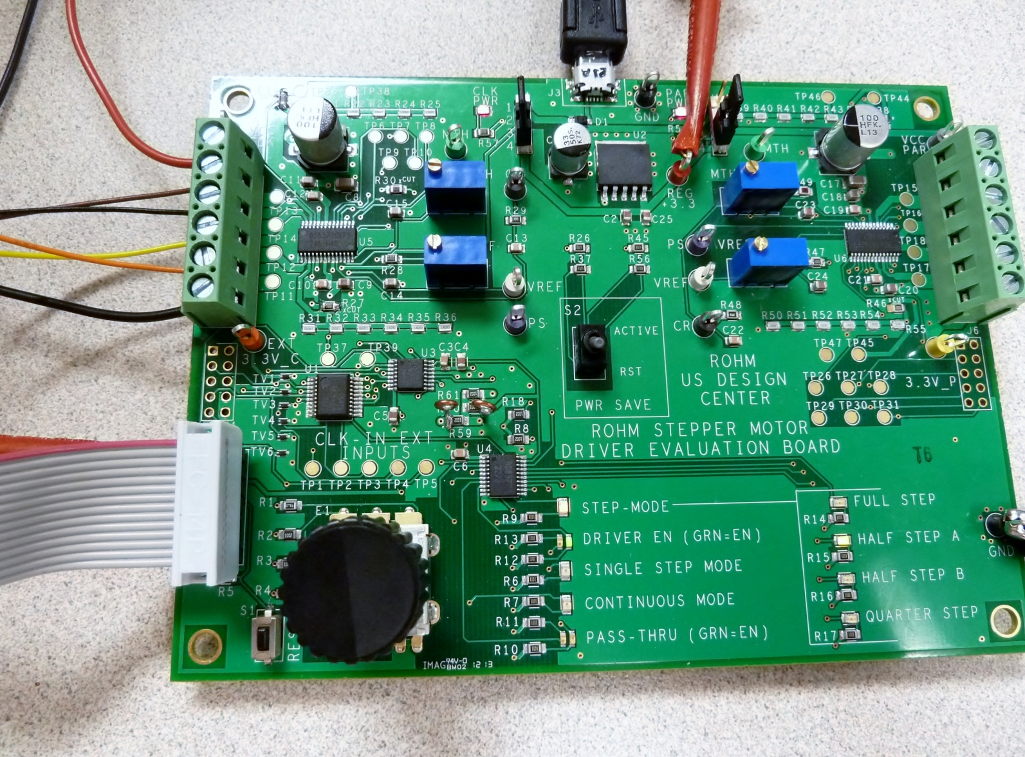
Stepper Motor Eval Board
Assembly Requests
Any questions, please feel free to contact Carl Schell at: cell: 313.414.6481

Slide 2
Request Overview
Cut Trace at two points on bottom of PCB
Add jumper to top of PCB
Place components R19, R27, R38 & R46 (Previously listed as Do Not Populate). I will order these components today and provide them to you later this week. The only issue I see on this from your side is that your previous stencil was not cut for these 4 components…so this may require a new stencil??
The test points were placed correctly, but not oriented correctly (I had requested perpendicular to the edge of the board). I’m not sure if this is possible, but I will modify 1 of the 4 boards you provided me and provide it to you as a template of what I prefer. If not feasible, I will accept it as is.
The labels on the silkscreen at S2 are reversed from what I would like. I would like to see if you could make or order and place a nice sticker on the board near the switch to correct this.

Slide 3
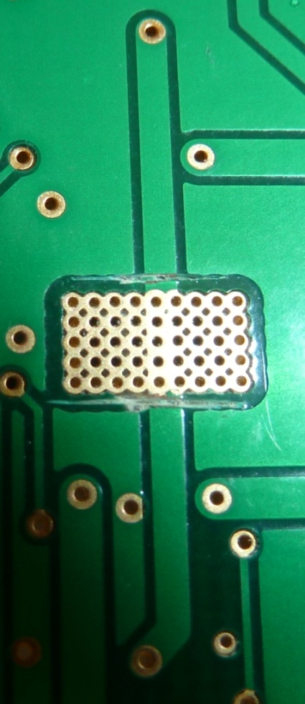
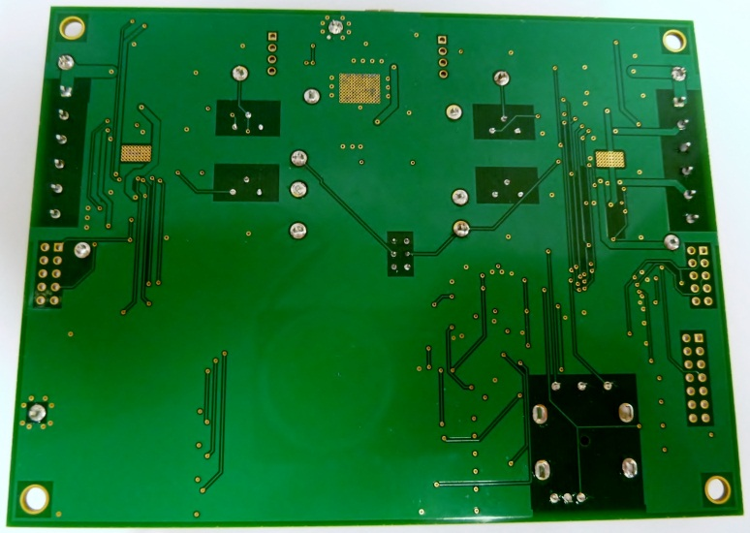
Request #1
Cut Trace at two points on bottom of PCB
Bottom Side of PCB
Sever the trace at two points

Slide 4
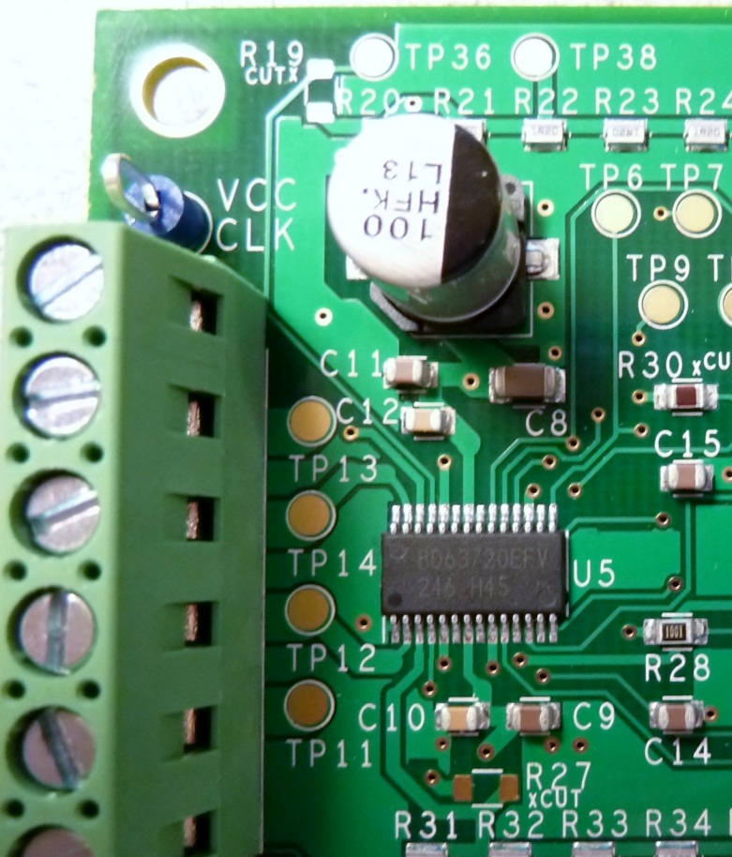
Request #2
Add jumper to bottom (preferred) or on top, if bottom is not feasible
Bottom Side of PCB
Top Side of PCB
PREFFERED METHOD!
Or…
PREFFERED METHOD!

Slide 5

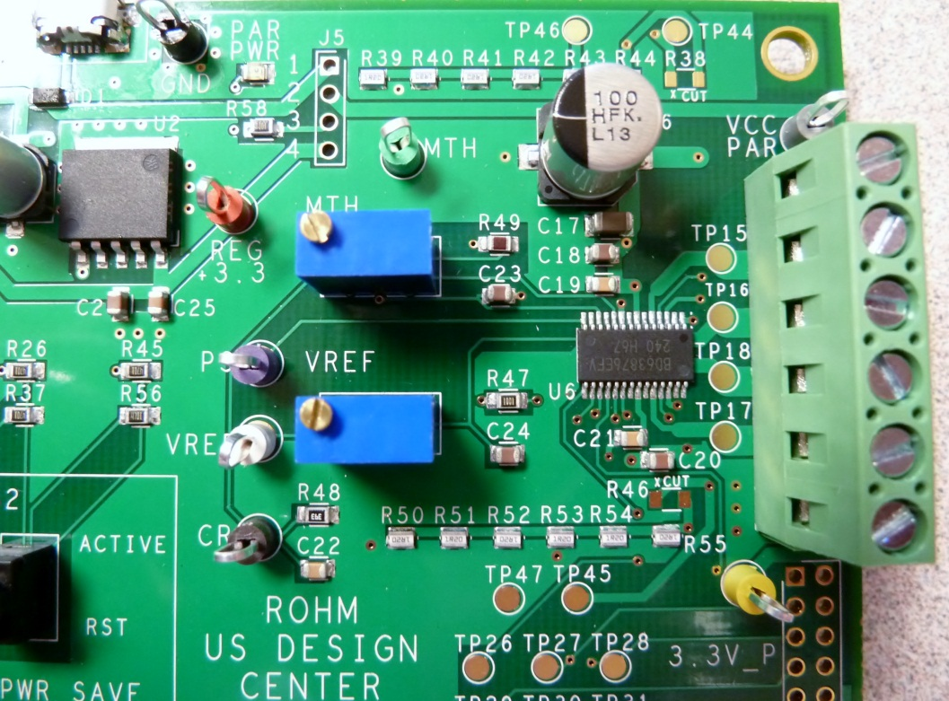
Request #3
Place components R19, R27, R38 & R46 (Previously listed as Do Not Populate).
Place (0Ω Jumpers) at: R19, R27, R38, R46

Slide 6
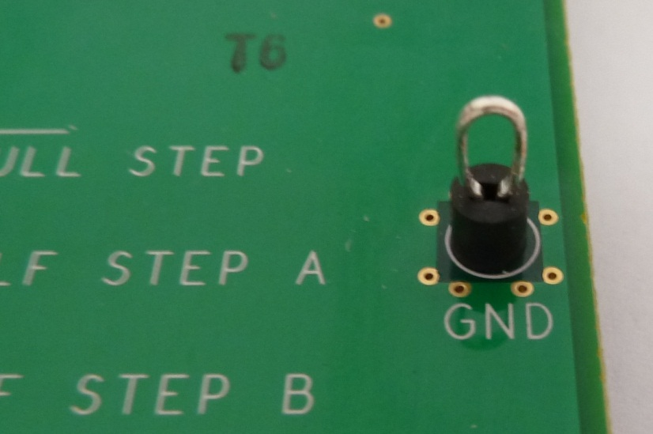
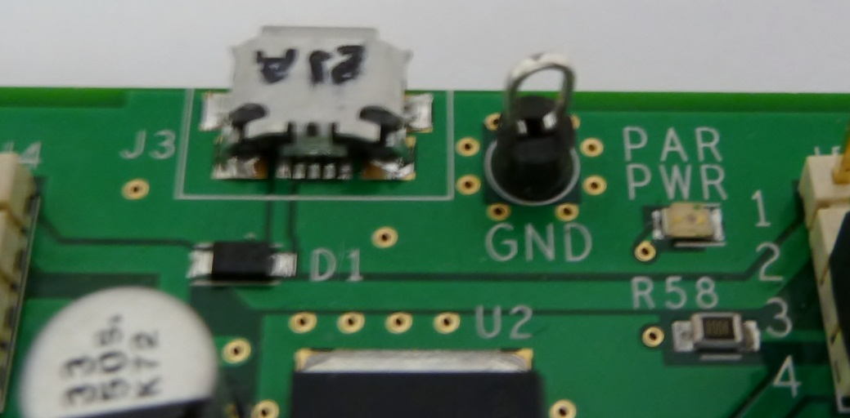
Request #4
Preferred Test Point Orientation is Perpendicular to the edge of the PCB…
Perfect – exactly as desired!
This test point’s orientation is not ideal...

Slide 7
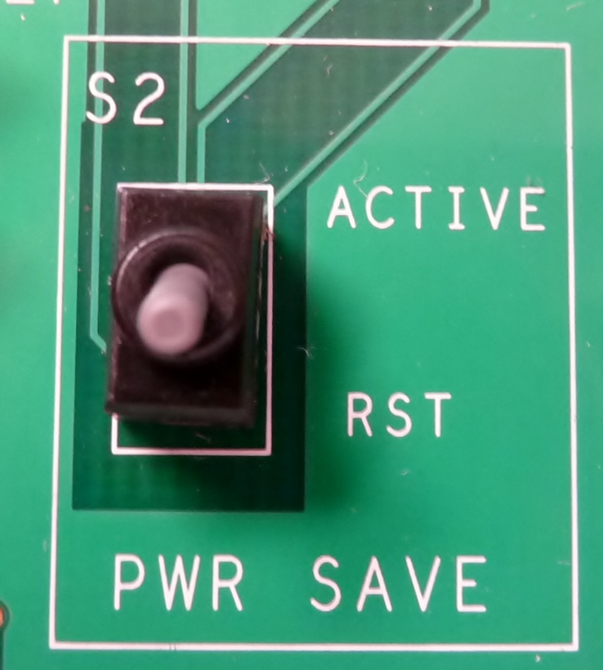
Request #5
Add Sticker to correct mislabeled Silkscreen…
Something like this…
RST
ACTIVE

